Slide 1
Yemen

Slide 2
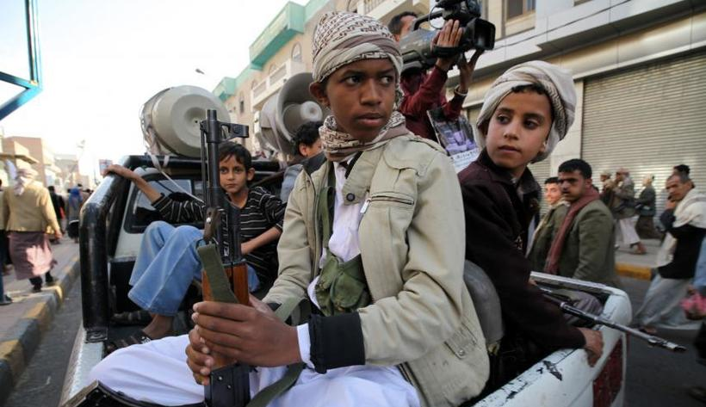
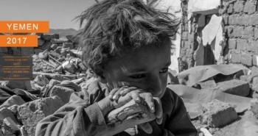
Country in Crisis

Slide 3
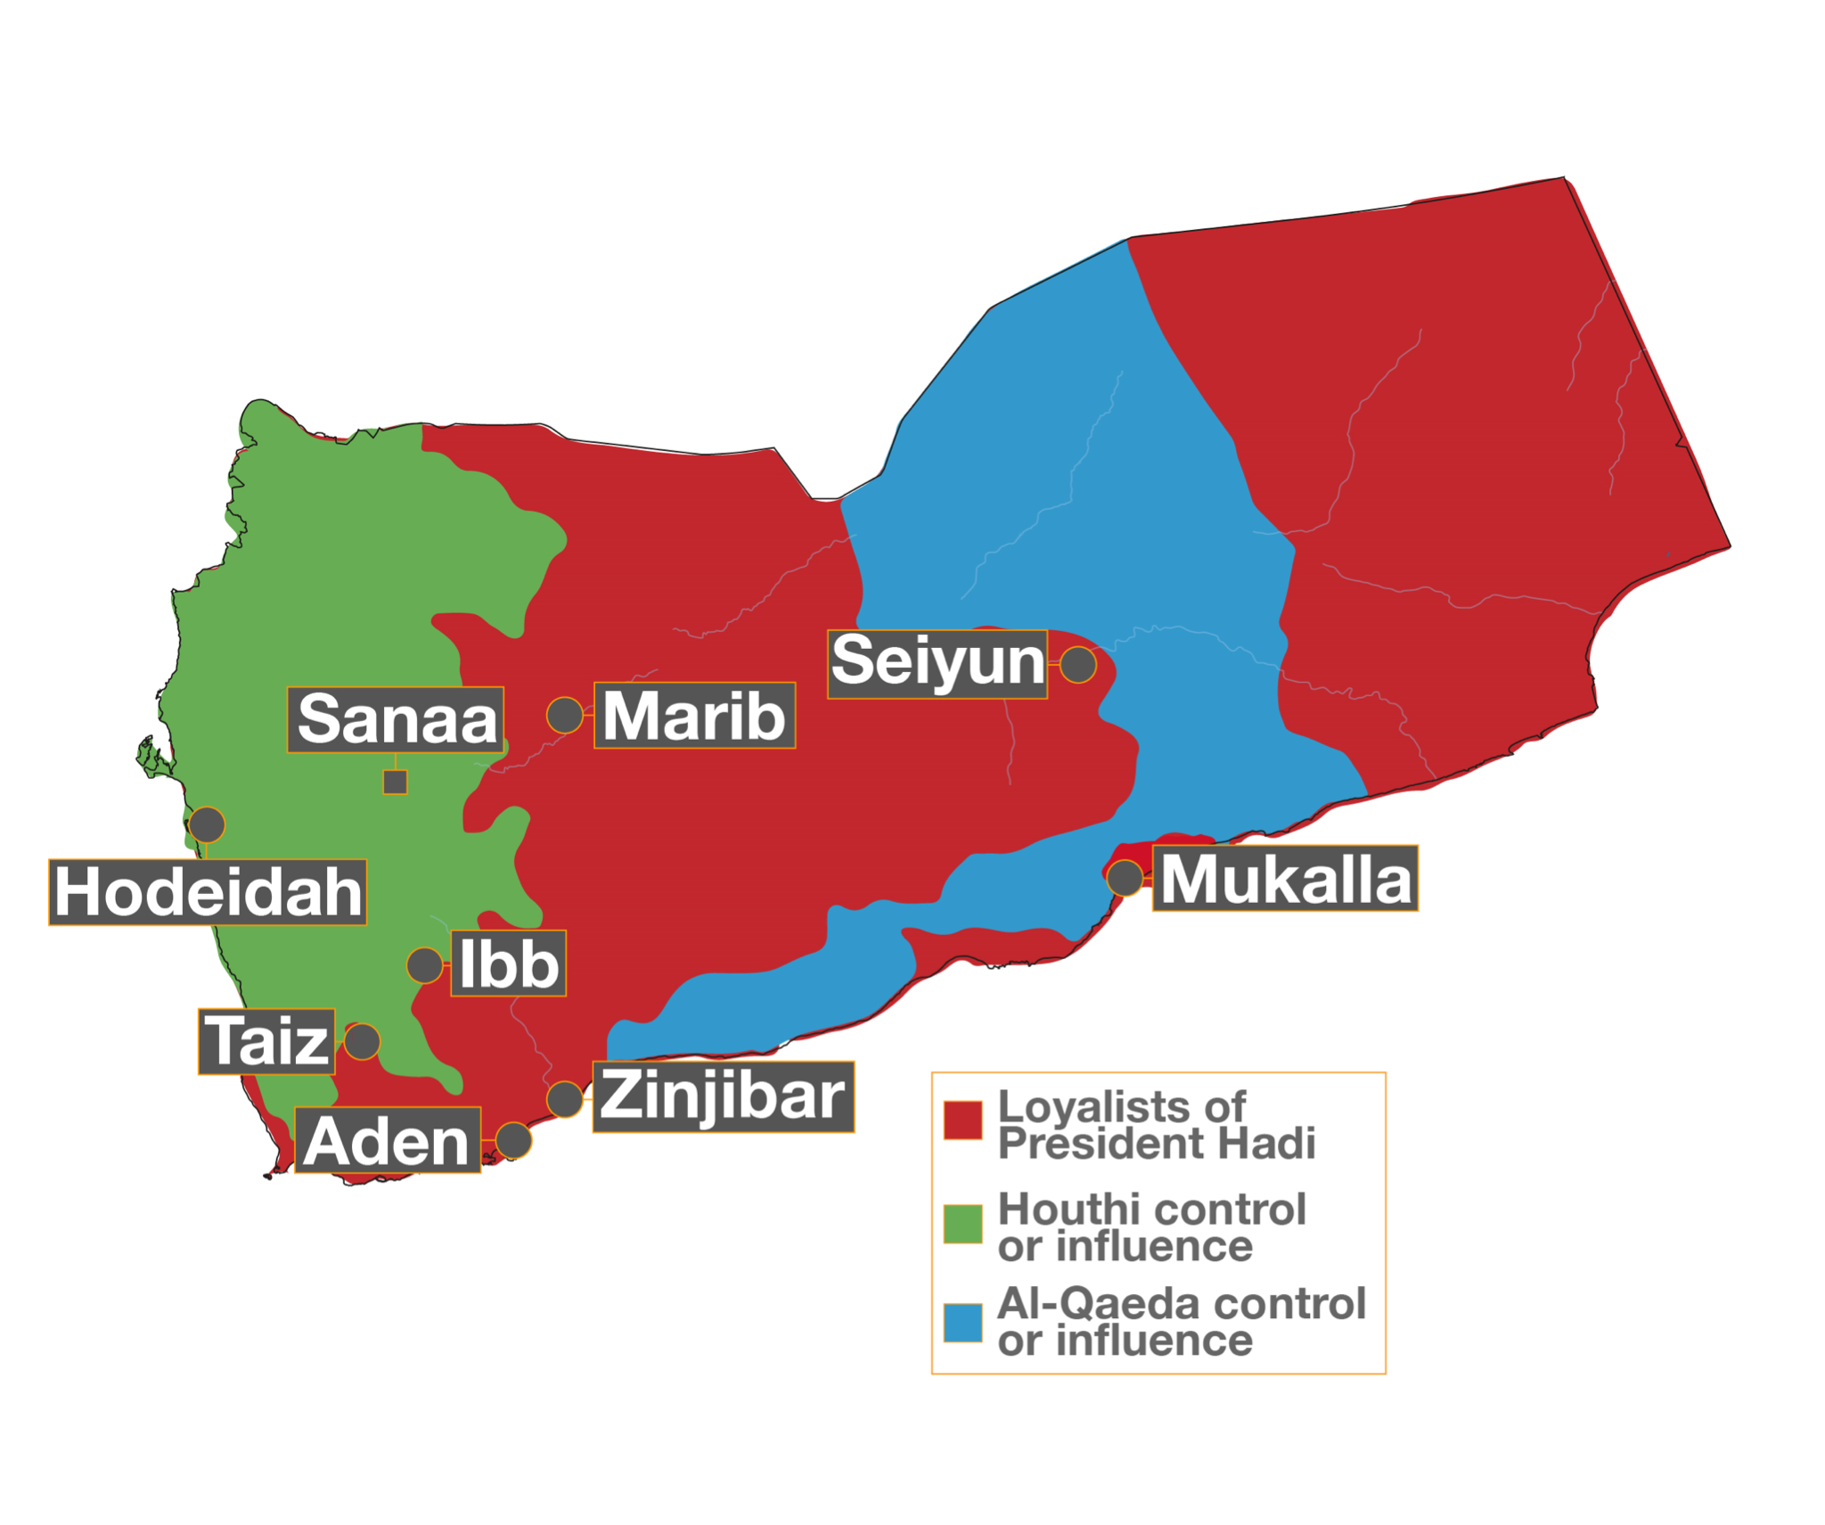

Slide 4
Exchange Rate (YER/USD)
215 YER
240 YER
370 YER
2015
2016
2017
Notes:
The Yemeni exchange rate has continued to fall, losing more than half of its value against other international currencies such as USD. (This based on ITDC’s financial records from 2015-2017 and the exchange rates obtained at the time), The impact is that imported goods (most of the Yemeni market) costs more local currency for the same item, which means purchasing power for the average Yemeni has been cut in half.
Money availability or liquidity has been an ongoing problem. For a significant portion of 2015-2016, there has been difficulty in obtaining hard cash. Often alternative currencies have been used like USD or Saudi Riyal. The banks have also been reluctant to release the cash they have, which make it very hard for individuals to make use of banks and made most Yemeni very reluctant to accept a check since their own bank will not honor it regardless of its source.

Slide 5
Increased Air Strikes
328 per month
(12 months)
946 per month
(first 6 months)
2015
2016
2017
Notes:
The number of airstrikes has increased in recent months with a significant rise over 2016.
2015: At the outset of the war (between March and December), there were XXX airstrikes
2016: During the entire 2016 year, there were 3,936 airstrikes in the 12 month period
2017: In the first 6 months, there have been more than 5,676 airstrikes
(Source: UN Protection Cluster bulletin)

Slide 6
Internally Displaced People
1 out of 10 Yemenis
1 out 26 Yemenis
2015
2016
2017
Notes:
IDP: 1 million (mid year 2015), 2.7 million (mid year 2016), 3.1 million (2017) – From Yemen HRP 2015 - 2017

Slide 7
Food Insecurity
45% of Yemenis
55% of Yemenis
2015
2016
2017
14.4 million food insecure
Notes:
Currently – 14.4 million people are food insecure in Yemen (55% of the population), “had limited or no access to sufficient, nutritious food, and were eating less than the minimum required to live a healthy life.”
Through our food survey from the most recent relief project – we saw more than 50% were skipping meals, not eating in order to feed children, and could only get food through relatives or the community (could not provide for themselves).

Slide 8
Comparison: Severe Food Malnutrition
Notes:
Source (Iraq):
Regional Food and Security Analysis Network
Iraq Food Security Quarterly Update, Jan-Mar 2017
Source (Syria):
OCHA humanitarian country teams
2017 Humanitarian Needs Overview: Syria
Source (Yemen):
OCHA humanitarian country teams
2017 Humanitarian Needs Overview: Yemen
Relief Web
Yemen Needs Urgent Assistance to Prevent Famine, March 2017
http://reliefweb.int/report/yemen/yemen-needs-urgent-assistance-prevent-famine

Slide 9
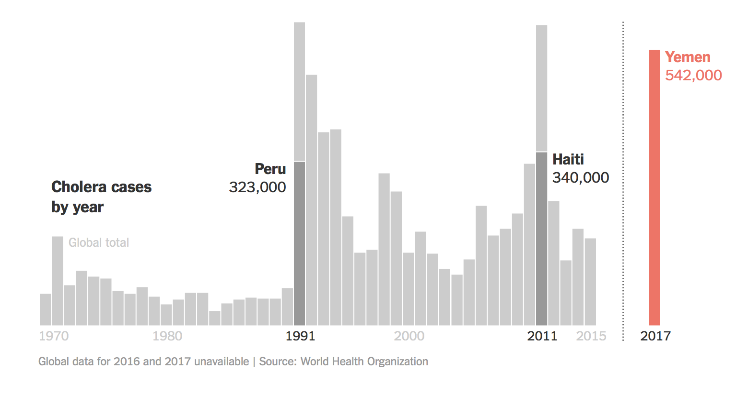
Cholera – by the end of 2017, over 1 million cases of cholera in Yemen

Slide 10
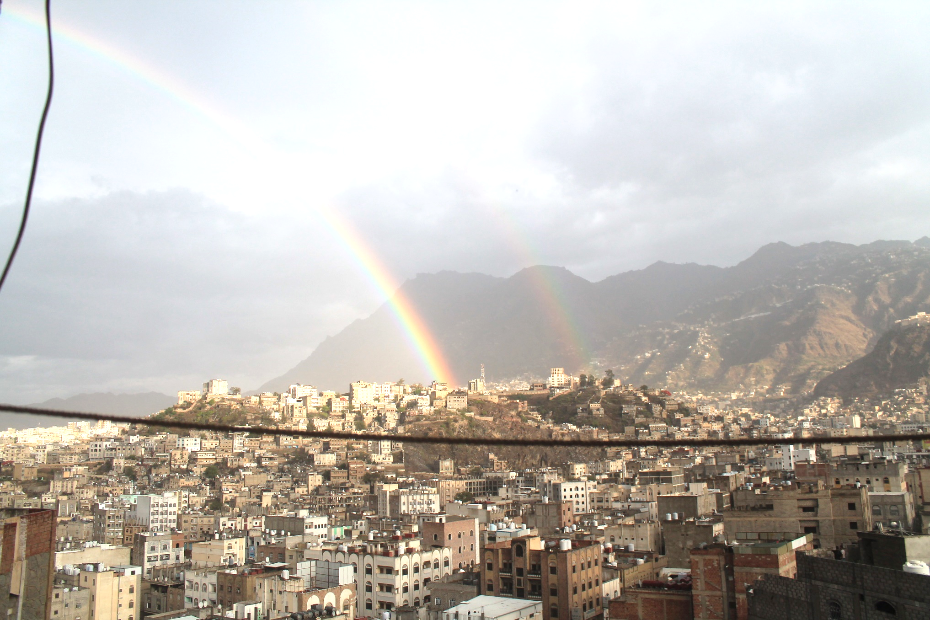
Pray for the Crisis in Yemen
For violence, hunger, ignorance and fear to stop.
That Christ would make himself known to many in Yemen.
For God to bring peace, love and hope to Yemen.
That the seeds of extremism being sown into the Yemeni people would not take root or bear fruit.

Slide 11
Pray for the Faith Communities in Yemen
That more Yemenis would hear the message and accept Christ.
For isolated believers throughout the country who think they’re the only Yemeni Christians in the country; that the Yemeni Church could find these believers and welcome them into community.
For the safety of the church in Yemen and for their protection as they gather together as families and celebrate baptisms together as a community.
For God to orchestrate marriages between believers in Yemen and for the spouses of believers who have not yet come to faith.

Slide 12
For those working with humanitarian teams and believers from outside the country to be wise and sensitive in providing mentorship.
That God would send a Spirit of forgiveness to Yemen and that the violence, ignorance and fear would be replaced with hope, peace, and love.
That the seeds of extremism being sown into the Yemeni people would not take root or bear fruit.

